Slide 1

DEPARTMENT OF ARTIFICIAL INTELLIGENCE AND DATA SCIENCE
Artificial Neural Networks and Deep Learning: 21ADG64
LA1 - Seminar
“Introduction to Neural Networks and its Techniques”
Presented By
M.Sreemitha
1NT21AD029
Name of the Course Instructor Dr Meenakshi

Slide 2

CONTENTS
Introduction and Motivation
Methodology and Approach
Results and Analysis
Conclusion and Future Recommendations
Github link of PPT and Code
References

Slide 3
INTRODUCTION
Neural networks are a powerful machine learning technique inspired by the biological structure and function of the human brain. They are capable of learning complex patterns and relationships in data, making them versatile for a wide range of applications.
What are Neural Networks?
Interconnected Nodes
Neural networks are composed of interconnected nodes, similar to the neurons in the brain, that transmit signals between each other.
Adaptive Learning
Neural networks have the ability to learn and improve their performance on a task through exposure to data, without being explicitly programmed.
Nonlinear Modeling
They are well-suited for modeling complex, nonlinear relationships in data that traditional algorithms may struggle with.

Slide 4
BIOLOGICAL INSPIRATION
Neurons Neural networks are inspired by the biological structure of the human brain, which is composed of interconnected neurons that transmit signals. | Synapses The connections between neurons, called synapses, are strengthened or weakened through learning, similar to the way neural networks adjust their internal parameters. | Parallel Processing The brain's ability to process information in parallel is a key inspiration for the parallel processing capabilities of neural networks.

Slide 5
Working of Neural Networks
Lets consider a neural network for email classification.
In an email classification neural network, features like email content, sender information, and subject are input into the network. These features, adjusted by weights, pass through hidden layers. Through training, the network learns to recognize patterns indicating whether an email is spam or not. The output layer predicts whether the email is spam (1) or not (0). With backpropagation, the network refines its weights, becoming skilled at distinguishing between spam and legitimate emails, making it useful for tasks like email filtering.
Input Layer
The input layer receives the data to be processed by the network.
Hidden Layers
The hidden layers extract features and transform the data, learning complex relationships.
Output Layer
The output layer produces the final result, such as a prediction or a classification.

Slide 6
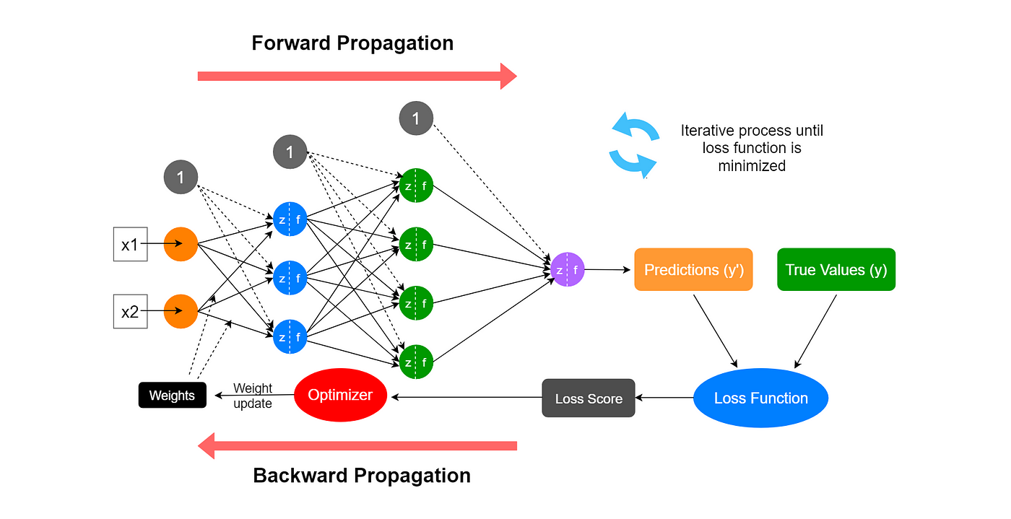
Forward Propagation

Slide 7
Forward Propagation
Input Layer: Each feature in the input layer is represented by a node on the network, which receives input data.
Weights and Connections: The weight of each neuronal connection indicates how strong the connection is. Throughout training, these weights are changed.
Hidden Layers: Each hidden layer neuron processes inputs by multiplying them by weights, adding them up, and then passing them through an activation function. By doing this, non-linearity is introduced, enabling the network to recognize intricate patterns.
Output: The final result is produced by repeating the process until the output layer is reached.

Slide 8
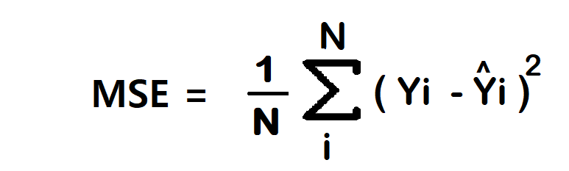
Backward Propagation
Loss Calculation: The network’s output is evaluated against the real goal values, and a loss function is used to compute the difference. For a regression problem, the Mean Squared Error (MSE) is commonly used as the cost function.
Adjusting weights: The weights are adjusted at each connection by applying this iterative process, or backpropagation, backward across the network.
Training: During training with different data samples, the entire process of forward propagation, loss calculation, and backpropagation is done iteratively, enabling the network to adapt and learn patterns from the data.

Slide 9
Backward Propagation
Activation Functions: Model non-linearity is introduced by activation functions like the rectified linear unit (ReLU) or sigmoid. Their decision on whether to “fire” a neuron is based on the whole weighted input.
Sigmoid
Introduces non-linearity and maps values between 0 and 1.
ReLU
Applies a threshold, setting negative inputs to 0 while passing positive inputs.
Tanh
Similar to sigmoid, but maps values between -1 and 1.
Softmax
Converts a vector of values into a probability distribution for classification tasks.
https://youtu.be/krTFCDCbkZg?si=1kMjNnqjCeNE8Zg8

Slide 10
Optimization
There are various optimization techniques to change model weights and learning rates, like Gradient Descent, Stochastic Gradient Descent, Stochastic Gradient descent with momentum, Mini-Batch Gradient Descent, AdaGrad, RMSProp, AdaDelta, and Adam. These optimization techniques play a critical role in the training of neural networks, as they help improve the model by adjusting its parameters to minimize the loss of function value.
Gradient Descent
In Gradient Descent, a single step is taken by considering the entirety of the training data. The process involves calculating the average of the gradients for all training examples, and this mean gradient is employed to update the parameters. This constitutes a singular step in the Gradient Descent process within a single epoch or iteration.

Slide 11
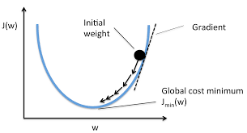
Optimization

Slide 12
Optimization
Stochastic Gradient Descent (SGD):
It’s a variation of the Gradient Descent algorithm. In Gradient Descent, we analyze the entire dataset in each step, which may not be efficient when dealing with very large datasets. To address this issue, we have Stochastic Gradient Descent (SGD). In Stochastic Gradient Descent, we process just one example at a time to perform a single step. So, if the dataset contains 10000 rows, SGD will update the model parameters 10000 times in a single cycle through the dataset, as opposed to just once in the case of Gradient Descent.
Select an example from the dataset.
Calculate its gradient.
Utilize the calculated gradient from step 2 to update the model weights.
Repeat steps 1 to 3 for all examples in the training dataset.
Completing a full pass through all the examples constitutes one epoch.
Repeat this entire process for several epochs as specified during training.

Slide 13
Optimization
Mini Batch Stochastic Gradient Descent:
We utilize a mini-batch stochastic gradient descent, which consists of a predetermined number of training examples, smaller than the full dataset. This approach combines the advantages of the previously mentioned variants. In one epoch, following the creation of fixed-size mini-batches, we execute the following steps:
Select a mini-batch.
Compute the mean gradient of the mini-batch.
Apply the mean gradient obtained in step 2 to update the model’s weights.
Repeat steps 1 to 2 for all the mini-batches that have been created.

Slide 14
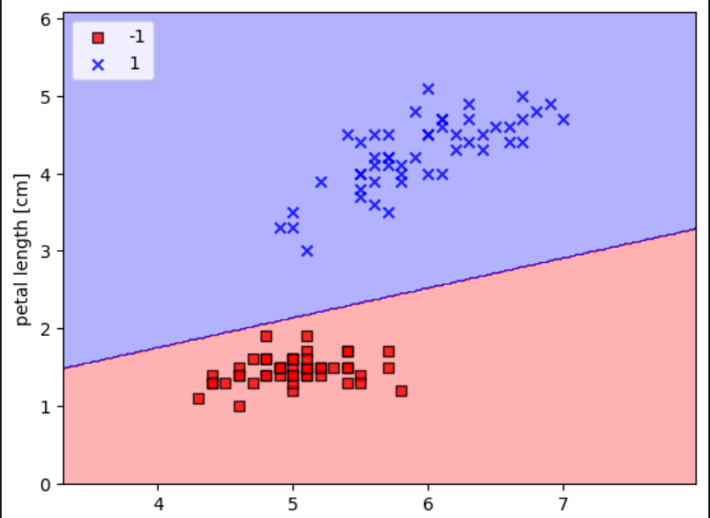
RESULTS AND ANALYSIS
e

Slide 15
CONCLUSION
In conclusion, neural networks have emerged as powerful tools for solving complex problems across various domains, ranging from pattern recognition and natural language processing to medical diagnosis and autonomous vehicles.
FUTURE RECOMMENDATIONS
Continued Research and Development: Further research and development efforts are needed to advance the capabilities of neural networks, including improving their scalability, efficiency, and interpretability. This involves exploring new architectures, optimization techniques, and training algorithms.
Ethical Considerations: As neural networks become increasingly integrated into society, it's crucial to address ethical considerations related to issues such as bias, privacy, and accountability. Ethical guidelines and regulations should be developed to ensure the responsible use of these technologies.

Slide 16
Github link of ppt and code
LINK
REFERANCES
https://www.geeksforgeeks.org/optimization-rule-in-deep-neural-networks/
https://www.youtube.com/results?search_query=neural+networks+CAMPUSX
https://www.techtarget.com/searchenterpriseai/definition/neural-network

